Slide 1

Pioneer Kochi, A Case Study
Pravin Anavaratham M
22ds2000111@ds.Study.Iitm.Ac.In

Slide 2
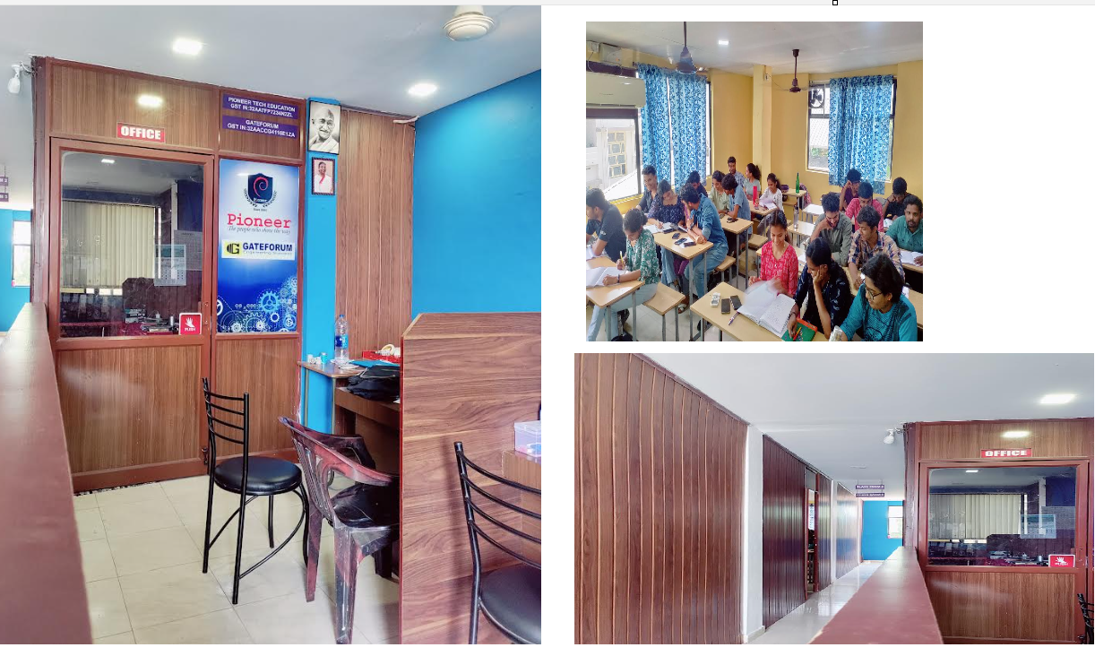
Organization Profile
Pioneer Kochi is a franchise of Pioneer Kerala, a leading educational institution headquartered in Calicut.
Specializes in coaching for various competitive exams, such as SSC JE, RRB JE, LET, SSC CGL, and SSC CHSL
Lead Generation Channels
Website Enquiries, Newspaper Advertisements, Third-Party Lead Providers

Slide 3
Challenges
Demand Dip
Enquiries not converting to Enrolments
Loss of revenue
Change in business landscape

Slide 4
Data Preparation
Data Collection
Data Cleaning
Transformation
Data Modelling
All data are between 2023 Dec- 2024 Dec
Enquiry Data
Enquiry Date
Contact
Location
Qualification
College
Payment Info
Name
VNO
Join Date
Payment Date
Course Info
Course Name
Fees
Hours Technical\Non Technical
Built Star Schema using fact and dimension tables
Used Power BI for model building
Excel Files
Remove Duplicates
Clean text data
Correct date formats
Added Calculated Fields.
Id columns for relationships.
Bridge tables for joins

Slide 5
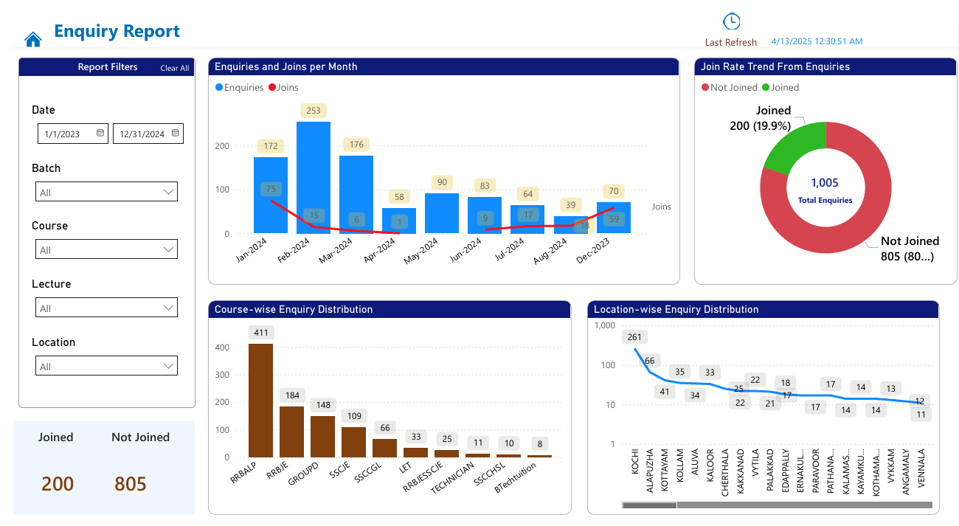
Results and Findings
Year in Review: Enquiry Highlights
From Interest to Enrolment: The Big Picture
Course Popularity breakdown
Geographic Demand Snapshot

Slide 6
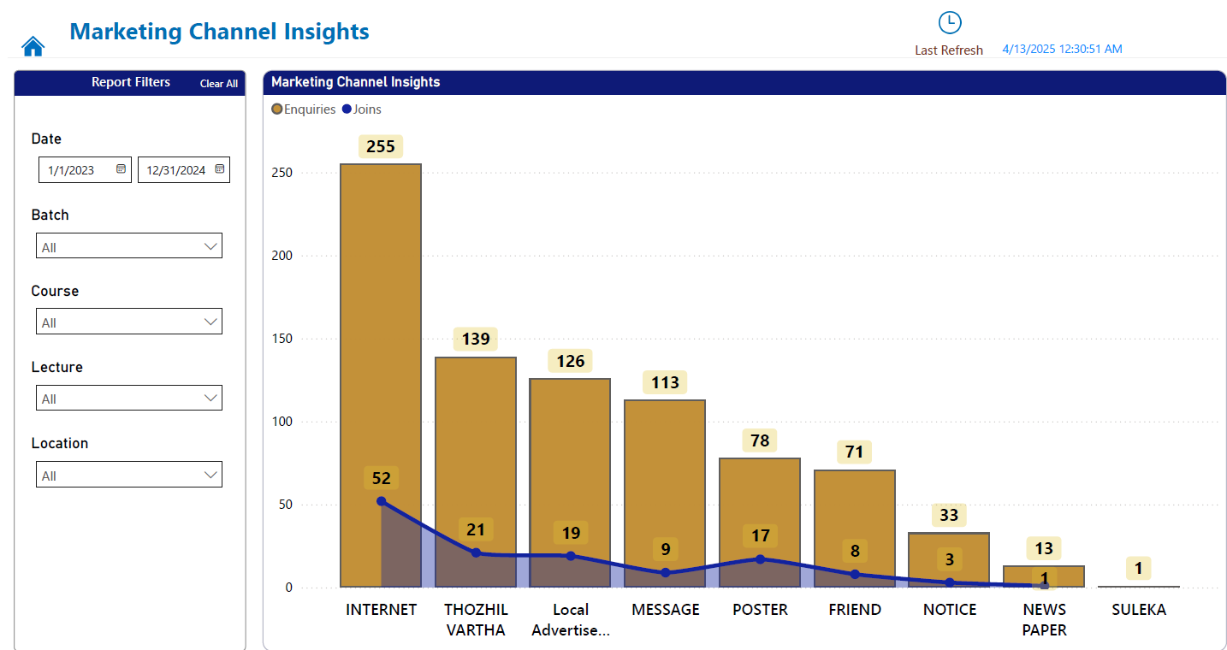
Marketing Channel Insights
Marketing channels drive business
Most enquiries are through internet – Website Enquiry, Google Advertisements, Social media etc.
Other communication channels are contributing well

Slide 7
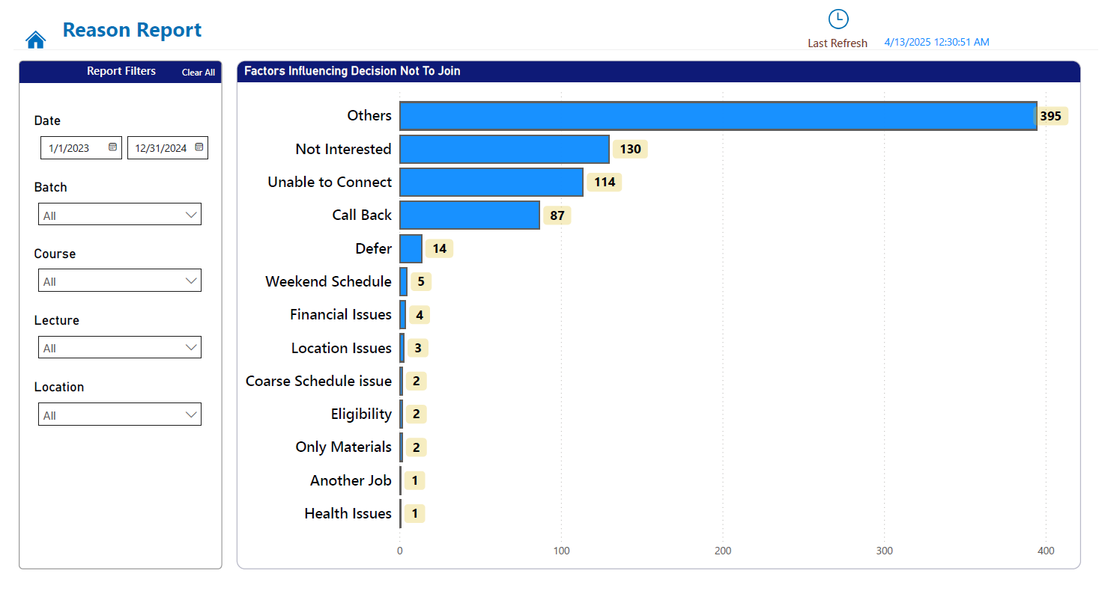
Reasons for Not Joining
Others indicate firm does not have a clear reason for the people who did not join
Not Interested are the candidates who explicitly stated their unwillingness to join
Unable to connect are the bad leads which significantly wasted the time and money for the firm
Call Back are the leads which business could not convert to enrolments – Lost Opportunity

Slide 8
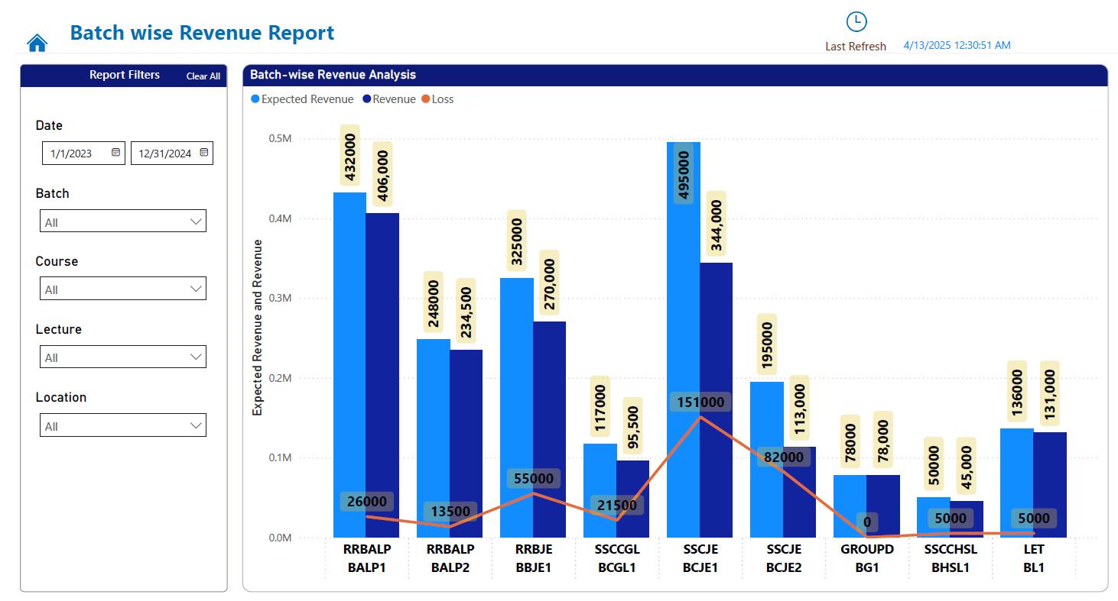
Earnings & Leakage Overview
Indicates revenue forecast and actual revenue for the firm
The gap indicates the revenue loss
After student enrolment firm was unable to retrieve full fees out of the student – Student not completing the full course, firm being too lenient on student payments

Slide 9
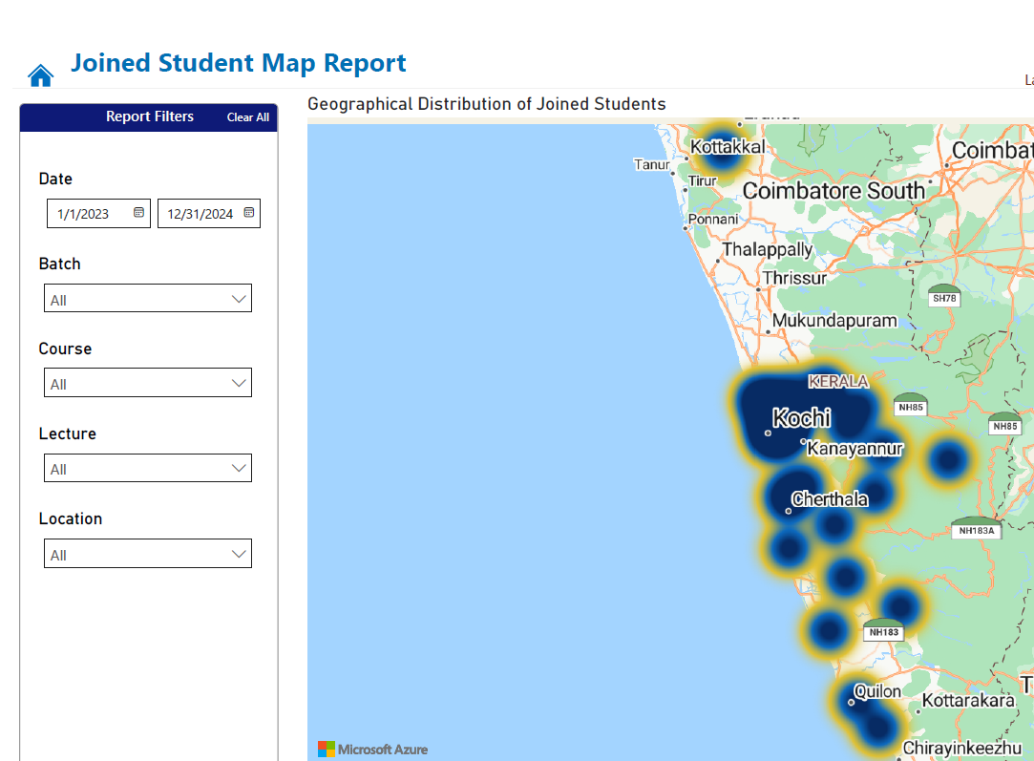
Geospatial Analysis
Geospatial Analysis was conducted to identify hot spots for marketing
Method: Mapped enquiry locations using latitude/longitude.
Insight: Kochi as the primary catchment area (targeted marketing recommended).
Helps identify key markets for leads
Strategize marketing in hotspots

Slide 10
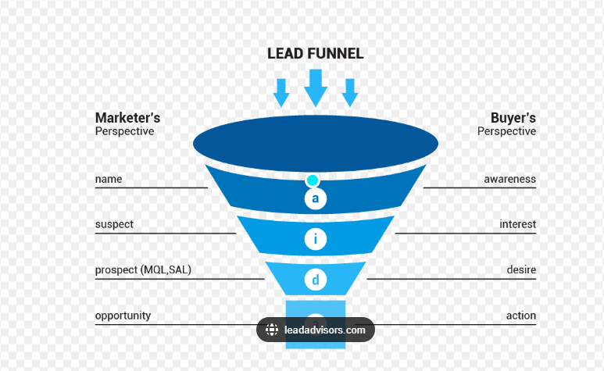
Recommendations
Revamp Lead Generation Strategy
Identify Drop Points
Reignite Interest
Location-Based Campaigns
Enhance Follow-Up and Engagement
Staff Education
Use CRM based system for Enquiry management
Use Enquiry Insights
Data-Driven Dashboarding
Power BI Dashboards: Create real-time dashboards designed to support strategic decision-making.
Increase online Presence
Building a brand
Engage your target audience through the channels they use most

